Slide 1

DEPARTMENT OF
INFORMATION TECHNOLOGY
REAL-TIME PROJECT
TITLE OF THE PROJECT :- Dual Authentication ATM
TEAM MEAMBERS:-
K.RASHMITHA(22AG1A1229)
K.VARDHAN(22AG1A1230)
V.HEMANTH(22AG1A1227)
INTERNAL GUIDE :-
Mr. M.SIVA KUMAR
Assistant professor

Slide 2
ABSTRACT
ATMs are crucial for banking convenience but face security challenges like theft and fraud. A new system combines biometrics (like fingerprints) with ATM cards and one-time passwords (OTP) to make transactions safer. Users verify their identity with their ATM card and biometrics. At the same time, they receive a temporary password on their phone for added security. This dual authentication method prevents problems like card cloning and theft. It's easier for users because they don't need to remember multiple PINs. Moreover,, if a card is lost, they can still access the ATM using their biometrics and OTP.

Slide 3
LITERATURE SURVEY
TITLE :- Card-Less ATM Transaction using Biometric andFace Recognition
PUBLISHER NAMES :- Mr. Manish, Mr.Chirag,Mr. Praveen,Mr. Darshan, Mr.D Kasim .
PUBLISHED YEAR :- July 2020
TITLE :- USE OF BIOMETRIC MACHINE FOR SECURITY IN ATM SYSTEM
PUBLISHER NAMES :- Mr.Sivakumar, Mr.Manoj , Mrs.Karovaliyaa.
PUBLISHED YEAR :- September-2022
TITLE :- Biometric based Fingerprint Verification System for ATM machines
PUBLISHER NAMES :- Mrs. T. Sangeetha,Mr.M.Kumargaru,Mr.S.Akshay,Mrs.M.Kanishka
PUBLISHED YEAR :- 23 February 2022

Slide 4
Existing system
The existing ATM system relies on card-based access, where users identify themselves using bank-issued ATM cards.
Transaction security is ensured through PIN authentication, requiring a Personal Identification Number.
ATMs offer core banking services, including cash withdrawals, balance inquiries, and fund transfers.
To combat fraud, the system incorporates PIN protection and anti-skimming technologies.
Overall, ATMs provide 24/7 access to essential banking services, enhancing convenience for users.

Slide 5
PROPOSED SYSTEM
We propose a solution for ATM card users that integrates both biometric authentication and traditional ATM card usage.
This dual authentication system offers users greater flexibility and security when accessing their funds.
In situations where biometric authentication is impossible, users can easily switch to using their ATM card as a fallback option.
Furthermore, our system includes additional security measures such as OTP verification for transaction authentication, adding an extra layer of protection against unauthorized access.
Overall, our solution aims to streamline the ATM experience, making it more convenient and secure for users."

Slide 6
APPLICATION OF THE PROJECT
Private Banking
Public Banking

Slide 7
SOFTWARE REQUIREMENTS
AND
HARDWARE REQUIREMENTS
SOFTWARE REQUIREMENTS:-
Python
HARDWARE REQUIREMENTS:-
Biometric scanners
Card readers
Secure PIN pad
Network connectivity

Slide 8
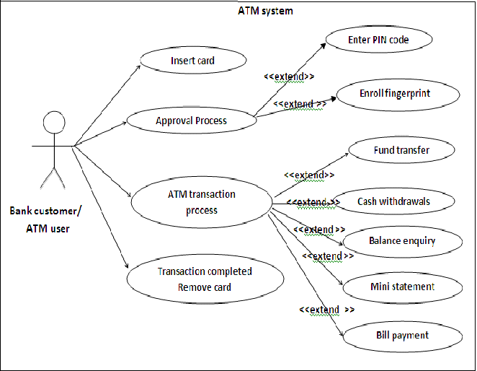
Architecture of the Project

Slide 9
Data Flow Diagrams

Slide 10

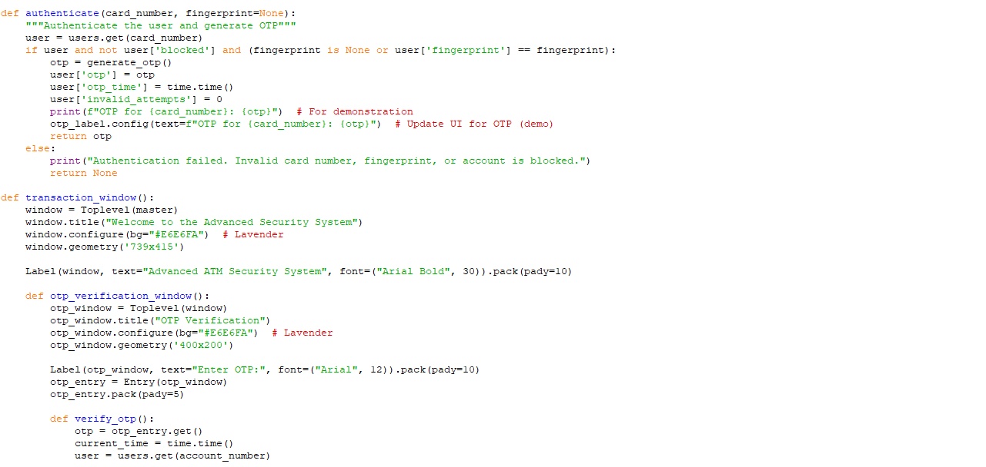
Sample source code

Slide 11
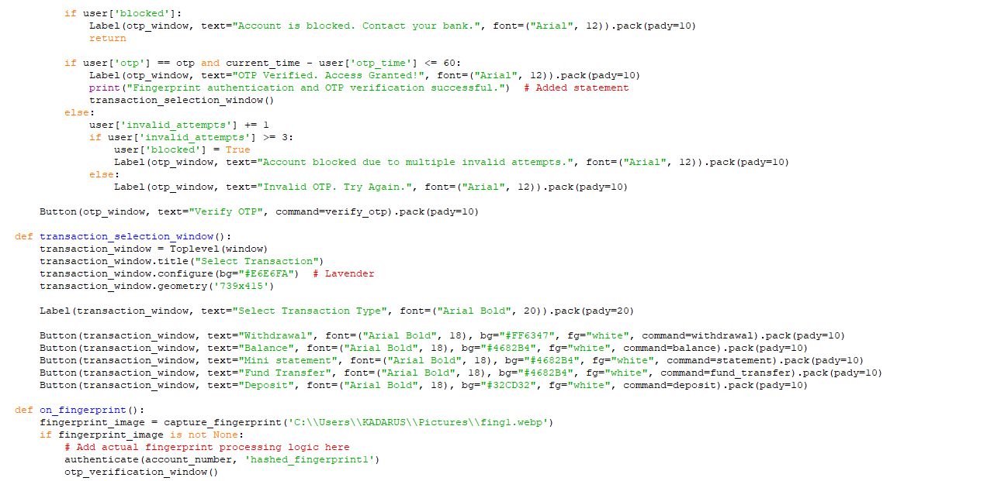
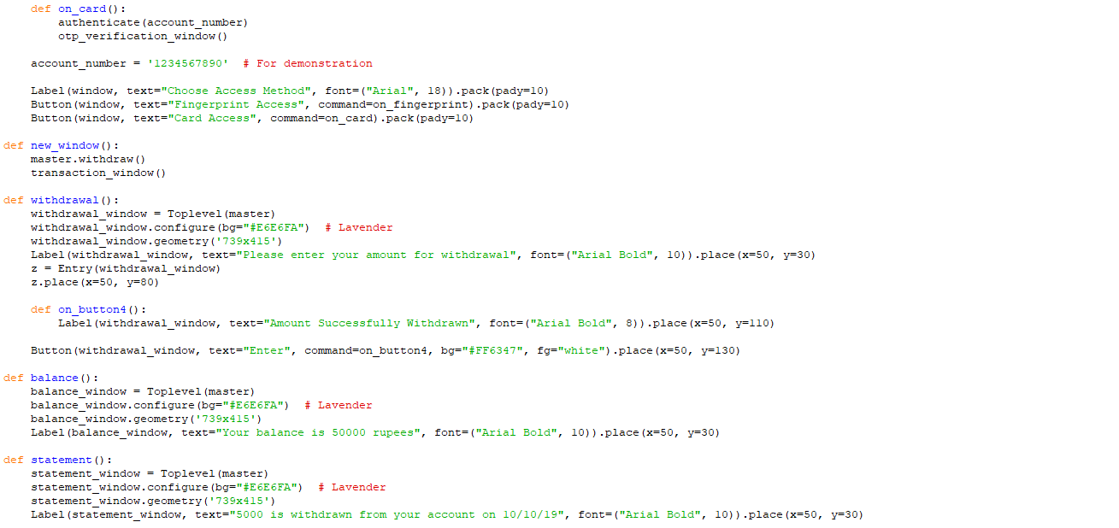

Slide 12
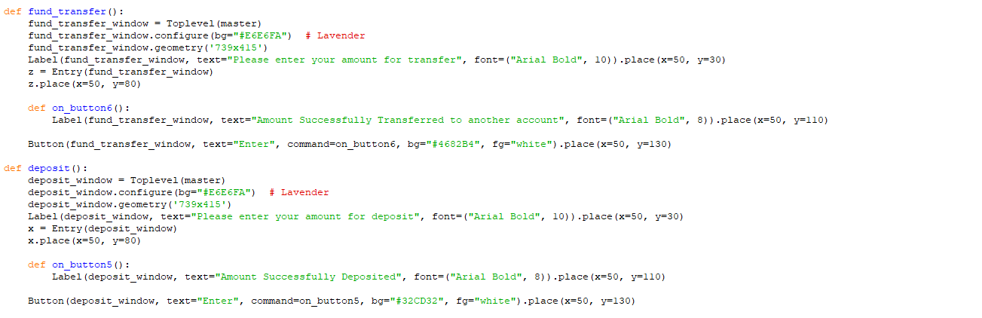


Slide 13
Testing
Biometric Scanner:
Accuracy: Validate the accuracy of fingerprint and facial recognition against known data.
Response Time: Measure the time taken for the biometric system to verify an identity.
False Acceptance Rate (FAR): Test to ensure that the system does not accept unauthorized users.
False Rejection Rate (FRR): Test to ensure that the system correctly recognizes authorized users.
Card Reader:
Functionality: Test the ability to read various types of ATM cards (magnetic stripe, chip).
Error Handling: Simulate unreadable or damaged cards to verify the system's response.
OTP Generation:
Generation: Ensure OTPs are unique and have a set expiration time.
Delivery: Verify that OTPs are correctly sent to registered phone numbers via SMS or a secure mobile application.
.

Slide 14
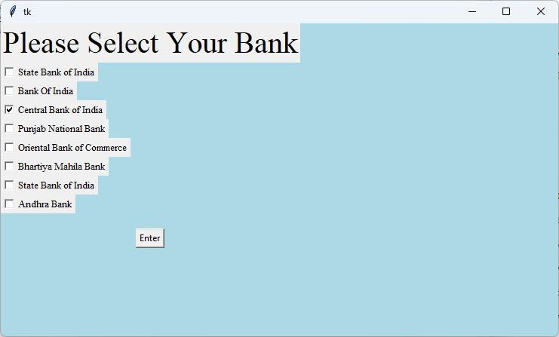
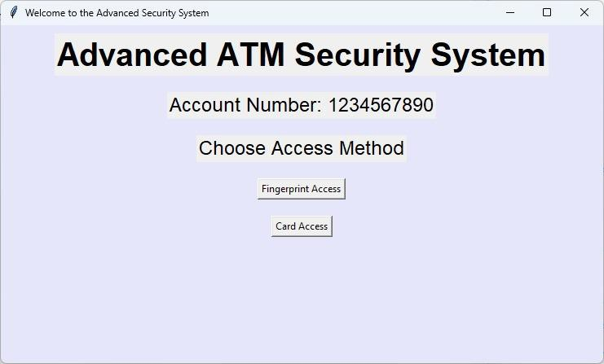
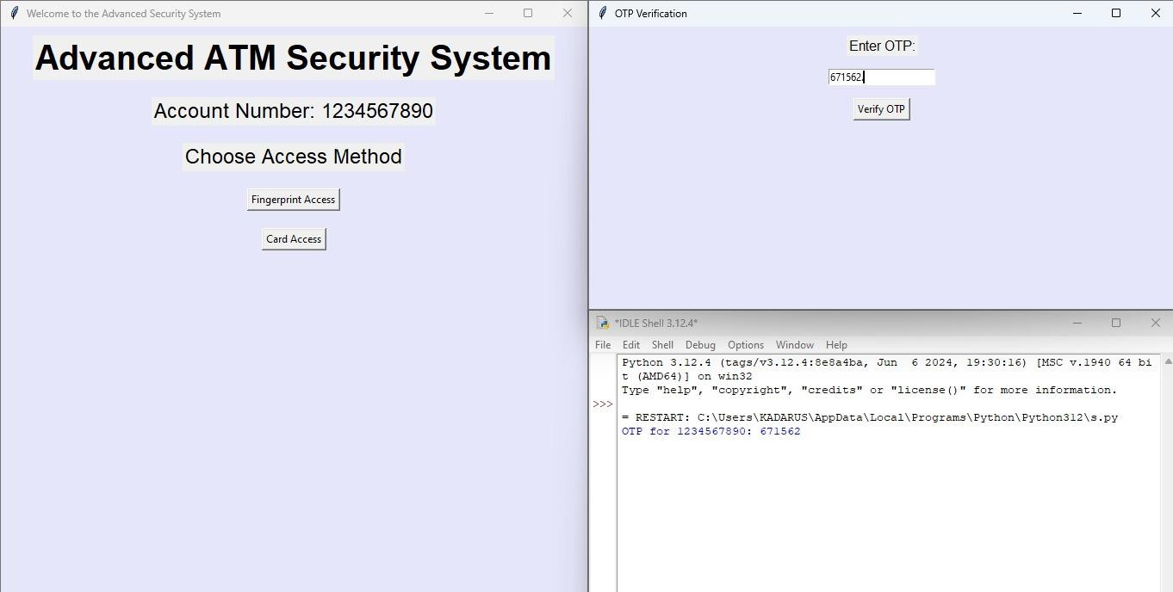
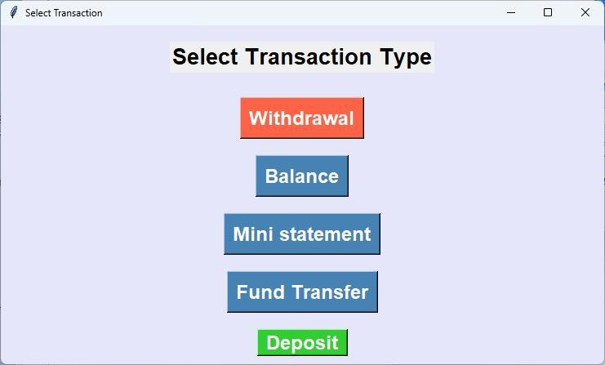
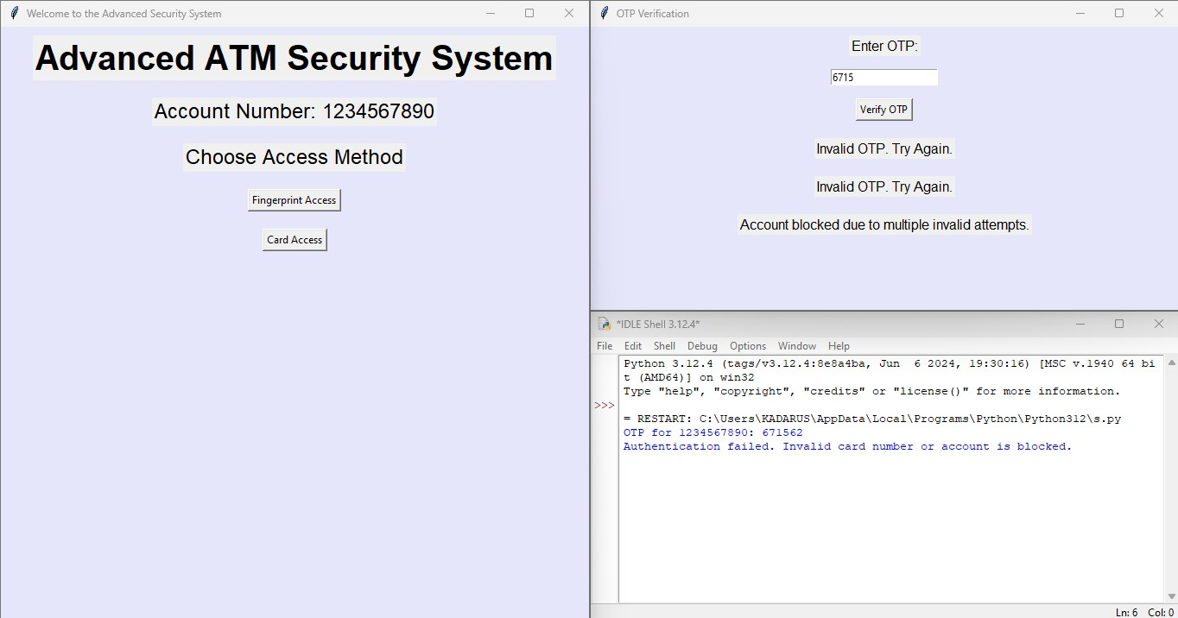
Screen Shots of the output

Slide 15
CONCLUSION
In conclusion, the integration of biometrics with ATM cards and one-time passwords (OTP) offers a robust solution to enhance ATM security. This dual authentication system significantly reduces the risk of theft and fraud by combining physical card verification with biometric recognition and an OTP sent to the user's phone. This approach not only prevents issues like card cloning and unauthorized access but also simplifies the process for users, as they no longer need to remember multiple PINs. Additionally, in the event of a lost card, users can still securely access their accounts using their biometrics and OTP, ensuring continuous and secure banking convenience.

Slide 16
Future Enhancement
Incorporating multi-biometric authentication, such as iris scanning and voice recognition.
2. Developing a dedicated mobile app for managing transactions and biometric data updates.
3. Implementing advanced encryption methods to safeguard sensitive data during transmission.
4. Integrating machine learning algorithms to detect and respond to fraudulent activities in real-time
5. Enhancing system scalability to handle increased user load efficiently.

Slide 17
References
1.[Link to paper 1](https://www.ijert.org/card-less-atm-transaction-using-biometric-and-face-recognition)
2. [Link to paper 2](https://www.ijcrt.org/papers/IJCRT1704227.pdf)
3. [Link to paper 3](https://www.irjet.net/archives/V6/i2/IRJET-V6I2216.pdf)

